Slide 1

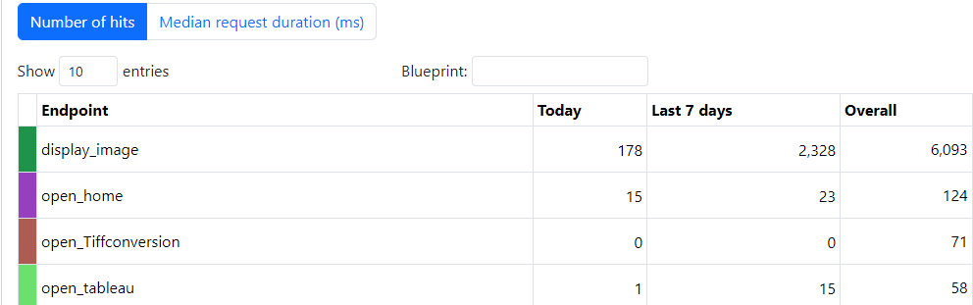
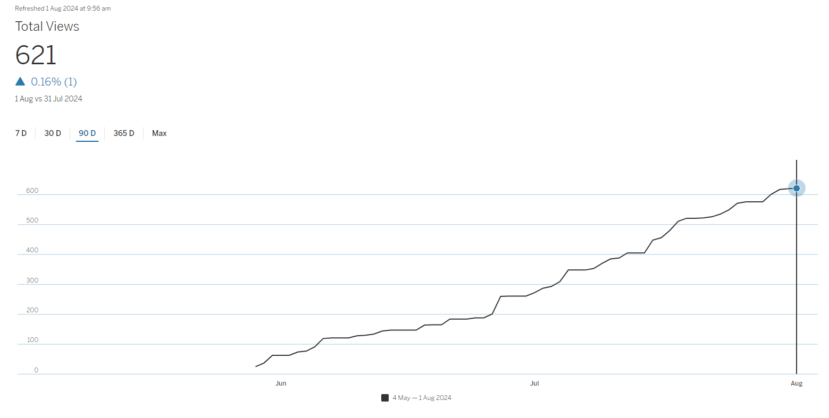





Company Improvements
Over 50 Man Hours Saved Daily!
Over 2248 Man Hours saved since 17 July
Over 621 Views on Dashboard
Over 2900 Files Converted (725 Man Hours)
~ 30 Engineers and Technicians Users
~ 100 Engineers and Technicians Impacted
Future Implementation to other machines (x 1-2)
Possible Implementation to other backend sites (8 Sites)

